Slide 1
Welcome!

Slide 2
Problem
What time is it?

Slide 3
12:30
IS IT?

Slide 4
NO!
IT’S LUNCH TIME!

Slide 5
A three-course meal in PCG
Jorge Palacios
AI Programmer, Freelancer
@pctroll

Slide 6
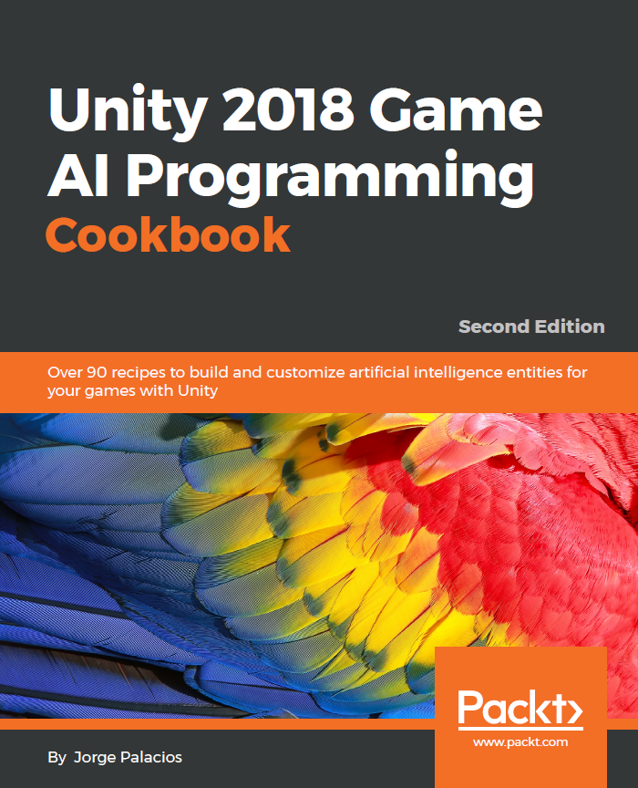


About me
B.Sc. Computer Science
Ms. Computer Science candidate
Author
Drummer
Rocket League lover
Love teaching/sharing

Slide 7














Experience

Slide 8
Let’s talk about PCG

Slide 9
P
PROCEDURAL
C
CONTENT
G
GENERATION

Slide 10
Problem
Why do we need/want PCG?

Slide 11
Problem
More hours of play.
Same/less budget

Slide 12
Evolving enemies through
Genetic Algorithm

Slide 13
Problem
We’d like to have adaptive enemies

Slide 14
The Solution
Enter Genetic Algorithm

Slide 15
Genetic Algorithm
in a nutshell
Create initial population (and shuffle them if necessary)
Evaluate individuals and keep the fittest
Generate new offspring from survivors, and mutate them a little

Slide 16





Genetic Algorithm
in a nutshell

Slide 17
Genetic Algorithm
in a nutshell
μ
λ

Slide 18
Genetic Algorithm
Initialize population of μ + λ individuals
Shuffle them (optional)
Evaluate all individuals with the evaluation function
Sort the population in order of ascending fitness
Remove the worst λ individuals
Replace the λ removed individuals with copies of the remaining ones
Mutate the λ offspring
If the population contains an individual of sufficient quality, or max number generation is reached, stop. Otherwise, go back to 2
Notes:
This slide is just for reference and for the assistants to keep when they download the slides

Slide 19
Editor explanation and run demo
How do we implement it?

Slide 20
Building Dungeons
using BSP

Slide 21
Problem
We’d like to have rooms connected by hallways

Slide 22
The Solution
B
S
P

Slide 23
B
BINARY
S
SPACE
P
PARTITIONING

Slide 24
Binary Space Partitioning
(the good parts)
Start with the whole area and split it in 2
In the middle or just a pseudo-random value
Keep splitting
(if necessary)
Split areas that are above minimum defined size
Connect cells with hallways
This could get trickier than expected

Slide 25
Binary Space Partitioning
A
B
C
D
E
F
G
H
I

Slide 26
Editor explanation and run demo
How do we implement it?

Slide 27
Assembling new levels
with n-grams

Slide 28
Problem
We’d like to imitate a level designer’s style

Slide 29
The Solution
Enter N-gram

Slide 30
N-gram for level generation
(or how to create a quattro stagioni)
Serialize your levels into slices
Transform those slices into an abstract version of letter, syllable, or word
Train the system using a trigram
Enjoy your freshly baked level

Slide 31











N-gram for level generation

Slide 32
N-gram for level generation

Slide 33
N-gram for level generation
a
b
c
c
c
d
e
f
c
c
g
h
c
c
c
c
c
c
-
-
-
-
a
b
c
d
a
a
e
f
a
a
-
-
-
-

Slide 34
Editor explanation and run demo
How do we implement it?

Slide 35
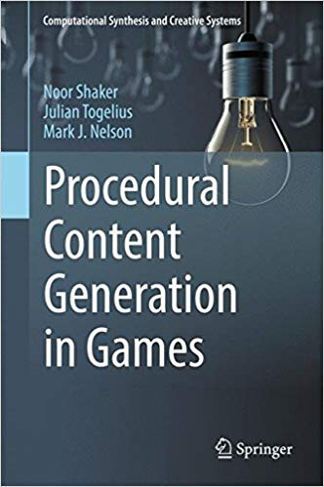

Where do we start?

Slide 36
Thank you!!!
¡Gracias!
Code and slides at:
github.com/pctroll/unitela2018
@pctroll jorge@reefaktor.com
Notes:
The github repo

